Slide 1
Dealing with Clients in a Garda Station
John F Martin & Co
28 Woodquay, Galway
info@jfm.ie
091 575075

Slide 2
Reasons for being in a Garda Station
Drugs Search
Drink Driving
Public Order
Detention for Questioning
Bench Warrant/Committal Warrant

Slide 3
The first questions!
Why is the client detained?
Are there any other bench warrants/committal warrants?
If there are bench warrants, deal with the reason for the arrest, then deal with the warrant in Court

Slide 4
Drugs Search
Section 23 Misuse of Drugs Act, 1977
A member of the Garda Síochána who with reasonable cause suspects that a person is in possession in contravention of this Act of a controlled drug, may without warrant search the person and, if he considers it necessary for that purpose, detain the person for such time as is reasonably necessary for making the search
Advise:
They are searching under a statutory power. Let them
If Garda finds something:
Attack the stop and subsequent search procedure at trial
If Garda fids nothing:
No Charge - Happy Days!
If client still unhappy, write for copy of custody record, and consider complaint to Ombudman.

Slide 5
Drink Driving
Call from station
Client will most likely be quite intoxicated
People just over the limit tend to be scared and just follow instructions, and therefore don’t call
Can usually be dealt with over the phone

Slide 6
Drink Driving
If sample given, and client is over the limit, possibility of fix charge notice and short disqualification
3 months to 6 months
If sample given, and reading is high enough for Court prosecution, range of disqualifications is
6 months to 3 years
Failure/Refusal to give sample
4 year disqualification

Slide 7
Drink Driving
“They want to take a sample”
Give the sample
If you fail in giving a breath sample, offer blood/urine
Mistakes can be made with blood/urine samples
People fill out forms incorrectly
Samples might not be sent on time
Section 4 (driving while intoxicated) or Section 5 (Drunk in charge) is easier to defend than Section 12 refusal
“They had no reason to stop me/arrest me”
That is an issue for hearing. Give the sample.

Slide 8
Public Order Offences
Power of Arrest – Section 24 Criminal Justice (Public Order) Act, 1994
Covers most of the Public Order offences
Except:
Disorderly Conduct (Section 5)
Wilful Obstruction (Section 9)
Power (usually) only exists while offence is being committed
If offence has ceased, can only ask the name and address of someone who a Garda suspects with reasonable cause has committed an offence
If that person refuses to give name & address, then power to arrest reignites
Some of these offences are arrestable offences in their own right, and therefore can be arrested & detained for questioning/charge
E.g. Riot, violent disorder

Slide 9
Public Order Offences
Usual Combination:
Section 4 (Intoxication to such an extent as to be a danger to oneself or another)
Section 6 (Threatening and abusive behaviour with the intent that it cause a breach of the peace or being reckless as to whether a breach of the peace will be occasioned)
Section 8 (Failure to Comply with direction of a member of an Garda Siochana)
Section 19(3) Resisting arrest
Client intoxicated

Slide 10
Public Order Offences
Client intoxicated
“Come down and get me out of here!”
Advice:
The sooner you shut up and calm down, the sooner you get out of there
Usually – Charged and released
Until recently no power to detain for being drunk
Gda would prepare charge which can “take a bit of time.”
The more stroppy the prisoner, the longer it would take to prepare a charge

Slide 11
Public Order Offences
Section 4A Criminal Justice (Public Order) act 1994
Inserted by Criminal Justice Act 2017
“[H]e or she may, if the member of the Garda Síochána for the time being in charge of the Garda Síochána station is of opinion that the person is intoxicated to such an extent as would give rise to a reasonable apprehension that the person might endanger himself or herself or other persons, be detained in custody for such period, not exceeding 6 hours from the time of his or her arrest, as the member of the Garda Síochána so in charge remains of that opinion.”
Effectively – Drunk Tank

Slide 12
Detention for Questioning
Huge area - Needs its own full 2 day CPD
Changes in recent years
Solicitor presence in interview

Slide 13
Detention for Questioning
Section 4 Criminal Justice Act 1984
Arrestable Offences
Section 42 Criminal Justice Act 1999
People removed from prisons for questioning
Section 30 Offences Against the State Act 1939
Section 2 Criminal Justice (Drug Trafficking) Act, 1996
Section 50 Criminal Justice Act, 2007
Murder of Garda, Murder using Firearm, Murder while committing offence under Offences Against the State Act, False imprisonment
Sections 16 & 17 Criminal Procedure Act 2010
Detention after and acquittal

Slide 14
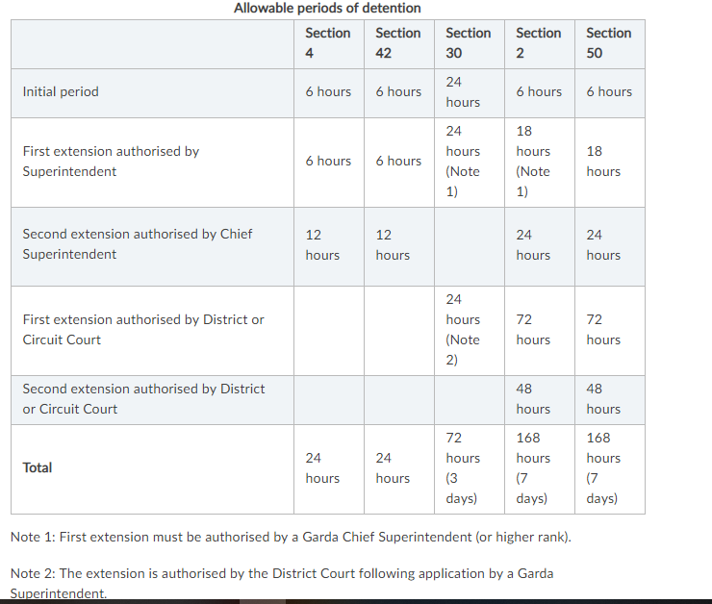
Detention for Questioning

Slide 15
Detention for Questioning
Initial Phone Call
Find out name of prisoner
Find out name of arresting member
Find out what is the alleged offence (theft, assault)
Find out what provision they are detained under
Find out time of initial detention
Give estimated time of arrival
Go to station

Slide 16
Detention for Questioning
On arrival at station
Note time you arrive at public office
Note time you are let in to the cell area
Speak to investigating member to ascertain:
Alleged facts
Witnesses
CCTV

Slide 17
Detention for Questioning
Speak to client
Does he/she need a doctor?
Especially relevant for prisoner with addiction issues
Does he/she need to contact someone
Legal Advice
Alleged incident

Slide 18
Detention for Questioning
Should I stay or should I go now?
DPP v Gormley; DPP v White [2014] IESC 17
Recognised right existed in Europe
Only went as far as the right to have legal advice in a garda station
Did not say you were entitled to have a solicitor present
DPP v Doyle [2017] IESC 1
Right to legal advice
No right to have solicitor present during questioning

Slide 19
Detention for Questioning
This is not the movies – very little solicitor input
Is the solicitor just correcting the garda questioning?
When I object to a certain question, garda will then put that same question to client correctly
If I fail to stop my client answering, a certain question, is my presence there enough that at trial the question is not excluded?
If the client says that he does not want me there, is the fact that I leave relevant? Will matters now be admissible because I could have stayed?
Time constraints for practice – Usual interview will last about 2 hours. Usually 2 interviews.

Slide 20
Bench Warrants
Can affect any of the above
Will be brought to Court
Before going to Court find out from the Garda
Objections to bail
Are gardai satisfied with the address?
Any conditions sought?
Sort the address first. Speak to client. Get him to call other family member to confirm alternative address – This is the one that can take time.

Slide 21
Committal Warrants
Straight to gaol
Do not pass go
Usually nothing you can do about this really
Article 40?
You get the ball rolling while they are brought to prison

