Slide 1
Sections 149 - 153 of the Legal Services
Regulation Act 2015
Fergal Mawe, Solicitor

Slide 2
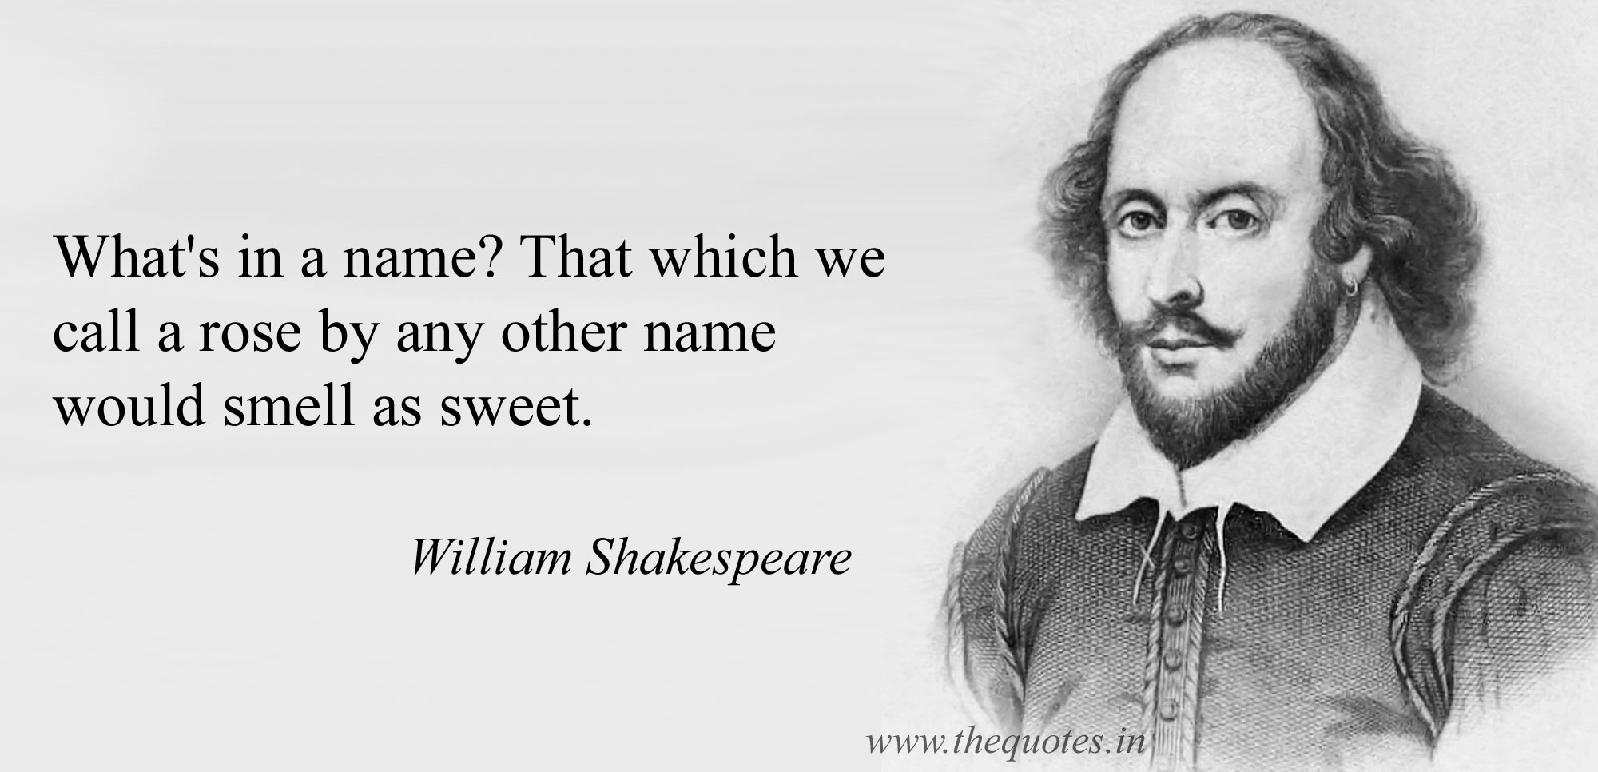

Slide 3
What’s in the Rose
Give it in writing
Explain that ‘charges’ will be paid to another person or organisation on the client’s behalf.
Include information in relation to VAT.
The actual amount, an estimate, or the basis of the charges if it is not practical at the time. If time is the basis of charge, time records must be kept and the hourly rate given.
Some fees may not be recovered even if successful
Circumstances where they may be required to pay other party's costs, even if they win
Failure to give revised s68’s when it should have been done, is viewed as an misconduct and the the Complaints and Client Relations Committee may direct the solicitor to charge less fees.

Slide 4
Issues seen with S.68
CCRC 2016 Annual Report:
“Unfortunately, there are continuing problems with the implementation of this provision with some solicitors observing it more in the breach than the observance….it really is ridiculous that it continues to be a problem”
Sending 1 s.68 letter outlying basis in vague terms
The stated charges bear no relation to the computation of charges

Slide 5
S.150 Notice
Upon receiving instructions you must either :
Discloses the costs that will be incurred in a S.150 Notice, but if it’s not practicable to do so
Send a holding notice that sets out the basis upon which the costs are to be calculated. However, “as soon as may be after it becomes practicable to do so” send another notice detailing the costs that will be incurred.
Many cases will require a minimum of two S.150 notices and some will require many more than that.

Slide 6
What needs to be in a S.150 Notice?
Written & in clear language
Likely to be easily understood by the client
Costs incurred to date
Certain/fixed costs to be incurred
Costs likely to be incurred
VAT
Basis of the calculation of the costs with reference to para 2 schedule 1
Obligations to provide further notices if you become aware of matters that would significantly lead to greater costs
Specify a period of time during which a solicitor shall not provide legal services [i.e. a suspension period of no longer than 10 days].

Slide 7
Added duties in litigation S.150 Notice
Outline of work & costs/likely costs in respect of each stage
Likelihood of engaging a barrister or expert witnesses
Likely costs/basis of costs for engaging a barrister or expert witness
Provide the client with information on their charges
Obtain express or implied consent
Financial consequences of “withdrawal from the litigation and its discontinuance”
Outline circumstances where the client would be likely to pay the costs of other parties
Outline circumstances where costs would not be recovered/fully from other parties

Slide 8
Suspension period exceptions
The suspension period remains in place pending either:
Receipt of confirmation from the client that they wish to proceed
The expiry date of the suspension period [not less than 10 working days].
It would contravene a statutory requirement, rules of court
It would prejudice the rights of the client in a manner that could not later be remedied
A court orders it
Where it involves litigation and a notice of trial has been served or a date has been fixed for hearing

Slide 9
S.151 Agreements
Written agreement is an alternative to S.150 notices
Must contain all the particulars required by s.150 e.g. Suspension period, incurred, fixed, likely
No other amount can be charged except to the extent otherwise indicated
Is amenable to adjudication under the legal costs adjudicator
Exiting SLA or OCG are allowable once they contain all of the particulars of a S.150 notice
No bill of costs – Invoice of costs and outlays and a copy of the agreement

Slide 10
S.152 Bill of costs
As soon as is practicable after the provision of services
Summary of services provided
Itemised statement of the amounts charged
VAT number and amount
Time spent where time is a factor in determining the costs
Amount of money recovered/payable to the client
The amount of legal costs recovered
be in the form as may be specified in rules of court
Procedures available to dispute any aspect of the bill

Slide 11
Disputing a bill of costs
Attempt to resolve the dispute by informal means [procedures given with the bill of costs]
client or solicitor may apply to the Legal Costs Adjudicator
Limitation periods:
Client - 6 months from service or 3 months from payment
Solicitor between 30 days and 12 months from service
Who pays for adjudication?
If costs are reduced by less than 15% = client
If costs are reduced by more than 15% = solicitor

