Slide 1
Land Registry Applications - Electronic Payment Methods
Presentation to Galway Bar Association Friday 13 July 2018
James O Boyle, Property Registration Authority

Slide 2
Transition to Electronic Payment
Government Policy
More secure means of payment
Reduced transaction fees
Convenient and easy to use
All payments can be managed through your www.landdirect.ie account

Slide 3
Electronic Payment Methods Available
Direct Debit Mandate
Deduction from www.landdirect.ie account
Debit Card/ Credit Card

Slide 4
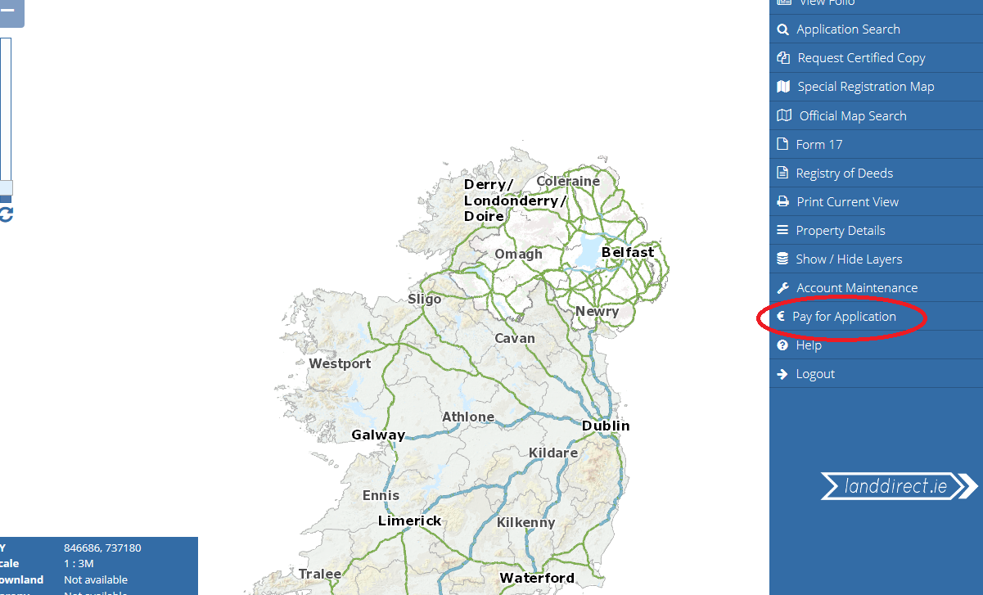
Pay for your application through www.landdirect.ie

Slide 5
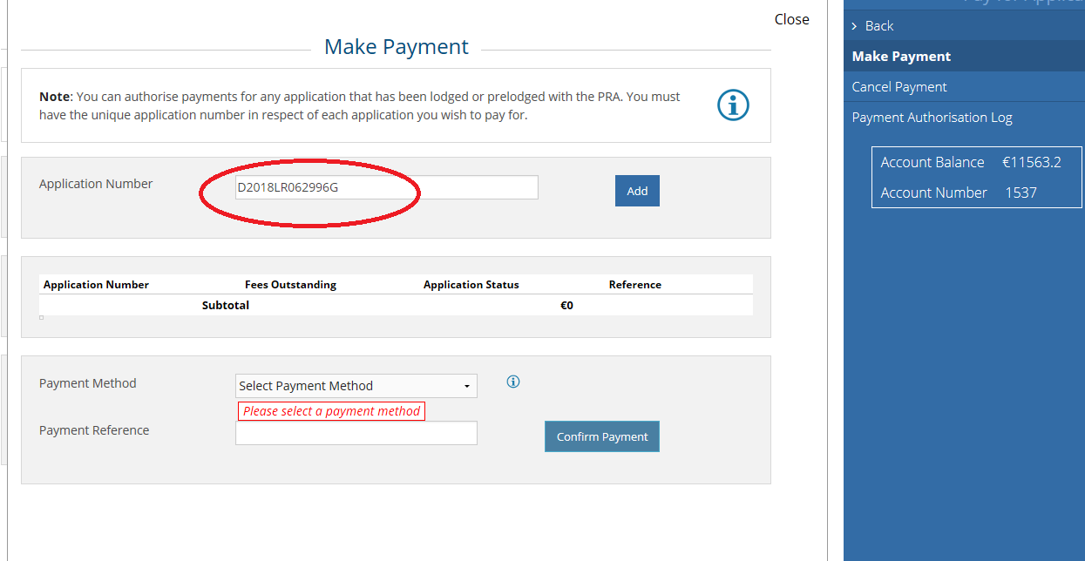
Enter Application Number

Slide 6
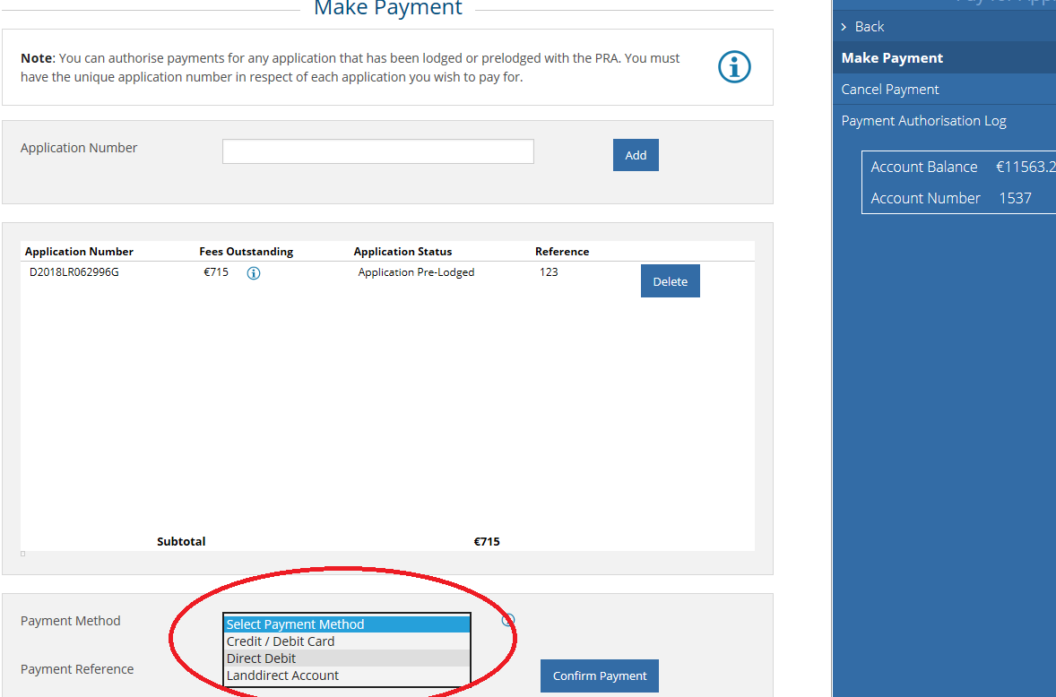
Choose Payment Method

Slide 7
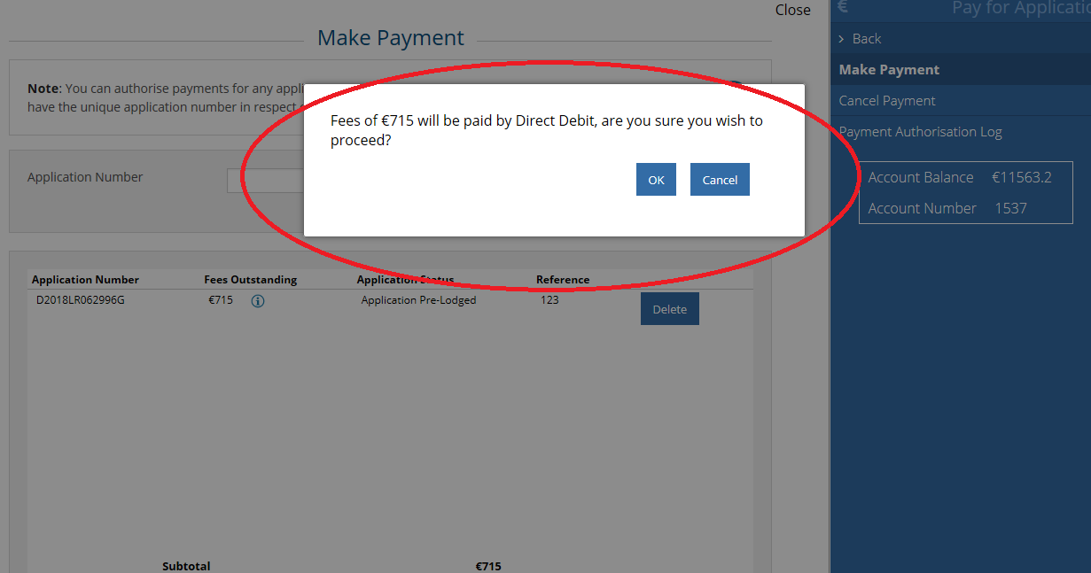
Confirm authorisation of your payment

Slide 8
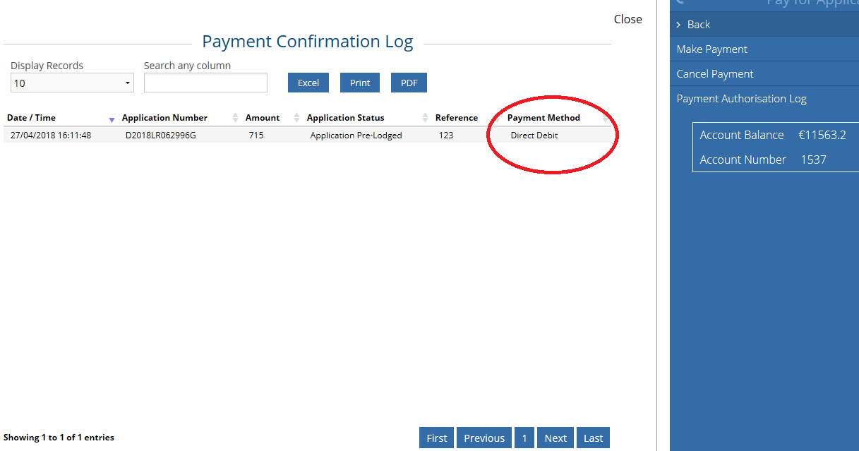
Electronic Payment Methods Available

Slide 9
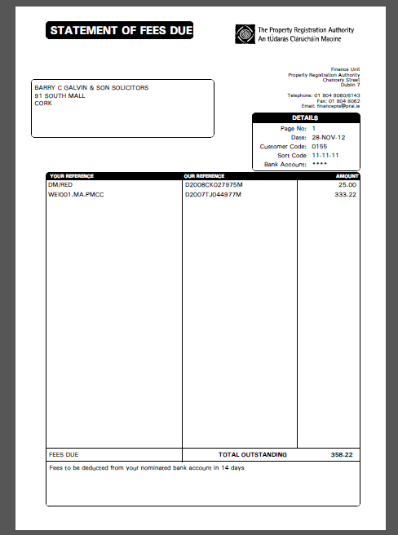
Remittance Details via Email

Slide 10
Signing up to electronic payments
Once off sign-up is required
Set up a ‘super user’ on your landdirect account
Assign ‘fee approver role’ to chosen users of www.landdirect.ie
If choosing to pay by Direct Debit, submit a signed mandate

Slide 11
Contact Us
You can contact the project team in our Roscommon office
* E-Mail: landdirectfees@prai.ie
( Phone: 0906 632606

