Slide 1

Galway Solicitors Bar Association Presentation
8th June, 2018

Slide 2
Who We Are
Set up in late 2006
Founding directors Conor Carey & Conor Murray
Offices in Headford, Moycullen & Sandyford, Dublin
12 employees currently
Regulated by the Central Bank of Ireland as Authorised Advisers

Slide 3
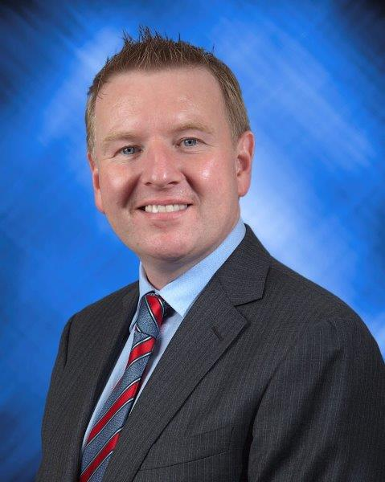
Conor Carey
27 years experience in the financial services industry
Previously worked with Ulster Bank Wealth & Bank of Ireland Private Banking
Holds a Bachelor in Business Studies (BBS) degree and the Qualified Financial Advisor (QFA) designation

Slide 4
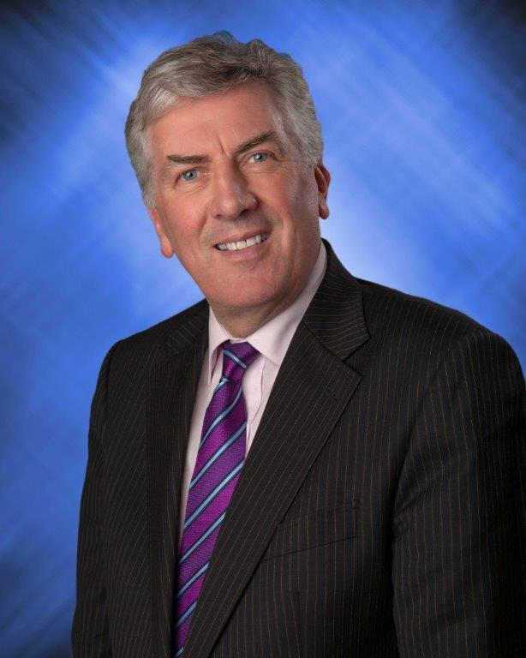
Michael Judge
40 years experience in the financial services industry
Previously worked with ACC Bank, Canada Life & Irish Life
Holds a Bachelor of Agri Science (BAgrSc) degree and the Qualified Financial Advisor (QFA) designation

Slide 5

Kevin Walsh
Current Galway senior football manager
Member of CMCC staff since 2013
Holds the Qualified Financial Advisor (QFA) designation

Slide 6
What We Do
Life & Specified Illness Cover
Income Protection
Business Protection
Retirement Planning
Savings & Investments
Mortgages

Slide 7
Contact details
Conor Carey
Mobile: 087 6661088
Email: ccarey@cmcc.ie
Michael Judge
Mobile: 087 1468780
Email: mjudge@cmcc.ie
www.cmcc.ie

Slide 8
Agenda
Life Insurance Claims – Paul Murphy Claims Manager Zurich
Business Insurance – Justin Kelly Technical Services, Zurich Life
Pension Adjustment Orders – Ger Tyrell, Technical Services, Zurich Life
Inheritance Tax Planning – Niall Concannon, Business Development Director, Zurich Life

Slide 9

Life Insurance Claims
Paul Murphy
Head of Claims
Zurich Life Assurance plc
8 June 2018

Slide 10
Agenda
Life Cover – Death Claims
Terminal Illness Benefit
Critical Illness Benefit
Public Attitude to Life Insurance and Non-Disclosure

Slide 11
Life Cover/Death Claims
Investment/Pension Products
Life Insurance
Claims Experience on Life Insurance
Causes of Death on Life Insurance
Issues at Claim Stage
11

Slide 12
Investment and Pension Products
Regular Premium Savings Policies
Single Premium Investment Bonds
Gross Roll Up Tax
Personal Pension Policies
Executive Pension Policies
Approved (Minimum) Retirement Funds

Slide 13
Claims Experience
Market rate in Ireland for payment of death claims is 97%
Really only 2 reasons for declining Death Claims:
  Non-disclosure
  Suicide in first 12 months
  Potentially claims could also be declined in cases of murder or fraud.
13

Slide 14
Cause of Death
2017 Paid Claims
Cancer | 203 (45%)
Strokes | 23
Heart Attacks | 21
Other Heart Conditions | 20
Suicide | 18 (less than 4%)
COPD | 10
RTA | 8
Pneumonia | 7
Kidney Failure | 5
Alzheimers | 5
14

Slide 15
Suicides
  18 suicides paid in 2017
  2 of these were paid as children’s benefits (16 & 17 year olds)
  Of the other 16 cases – 15 were male and 1 female.
  Age profile:
    6 were 30-40
    5 were 40-50
    5 were 50+

Slide 16
Cancer Death Claims
Of the 203 Cancer Deaths 42 were Lung Cancer.
Vast majority of Lung Cancers are caused by cigarette smoking.
Majority of these 42 clients were smokers up to death or had been smokers in the past and had given up.
Review of the 20 newest policies.
    13 declared themselves as smokers on the proposal
    the other 7 were non-smokers on the proposal form but on investigation we discovered that 6 of the 7 were ex-smokers.

Slide 17
Customer Survey
A client non-discloses smoking and dies a year later
Pay Nothing Pay Partial Pay Full
Car Crash 7% 10% 83%
Skin Cancer 11% 22% 67%
Heart Attack 14% 26% 60%
Lung Cancer 51% 36% 13%

Slide 18
However ………
“Would you be prepared to pay more for your own life insurance to cover the cost of some claims being paid out on people who did not provide important facts when their policy was taken out?”.
76% said No

Slide 19
Other Causes of Death on 2017 Paid Claims
Multiple gunshot wounds
Strangulation
Drowning
CJD
Heart Failure – Influenza
Methadone Toxicity

Slide 20
Average Sum Insured Paid out on Death Claims by Zurich in 2017 was (only) €94,521
Average Sum Insured Paid out on Death Claims by Zurich in 2017 on policies sold in the last 10 years was (only) €117,776
Of concern is that the median sum insured is only €50,000.
We paid 12 claims over €400,000 each which obviously pulled up the average
20

Slide 21
Duration in force until Death
35+ | 10
30-34 | 71
25-29 | 49
20-24 | 26
15-19 | 32
10-14 | 70
5-9 | 86
4-5 | 21
2-3 | 16
1-2 | 19

Slide 22
Issues with Documentation
Birth Certificate – rare but we do see mis-stated Dates of Birth
Grant of Probate – can be avoided if policies are sold on a joint ownership or Life of another basis.
Death Certificate – always look for an original of solicitor certified copy.
Interim Death Cert
22

Slide 23
Avoiding Delays with Grant of Probate
Ideally policies should be sold on a Joint Owner or a Life of Another basis.
If not and client is terminally ill they should consider either:
    Assignment to spouse
    Putting policy into Trust

Slide 24
Terminal Illness Benefit
Great concept?
Very sensitive claims.
Vast majority are Cancer victims.
What is Terminally Ill?
What is Insurance Industry’s definition of Terminally Ill?

Slide 25
We paid 64 Terminal Illness Claims over the last 3 years.
All were cancer with exception of 2 which were Motor Neuron Disease
Average Sum Insured paid is €234,000. The median is €150,000
Cannot easily explain why this is higher than the Death Sum Insured on the same block of business.
Lack of awareness of the benefit – reluctance to accept prognosis

Slide 26
Serious Illness
Claims Experience
Causes of Claim
26

Slide 27
Claims Experience
Market rate for payment of Serious Illness claims is 90%
Reasons for declining
  Non-disclosure
  Not meeting Policy Definition
  Greater potential for Fraud
27

Slide 28
Causes Critical Illness on Claims Paid 2017
Cancer | 141
Myocardial Infarction | 32
Stroke | 14
Angioplasty | 13
Multiple Sclerosis | 7
Heart Bypass | 6
Parkinsons Disease | 2
Cardiomyopathy | 2
Ulcerative Colitis | 2

Slide 29
We also paid one claim for each of the following:
Alzheimers
Aortic Graft Surgery
Bacterial Meningitis
Blindness
Coma
Encephalitis
End Stage Liver Failure
Loss of Independent Existence
Major Organ Transplant
Motor Neuron Disease
Traumatic Brain Injury
Structural Heart Valve Surgery

Slide 30
Cancer Claims by site
Breast Cancer 41
Bowel Cancer 22
Prostate Cancer 19
Lymphoma 10
Lung Cancer 6
Malignant Melanoma 6
Ovarian 5
Brain Tumour 4
Testicular 4
Thyroid 4
Kidney 4
Cervical 3
Other 13

Slide 31
Duration In Force for 2017 Paid Critical Illness Claims
20 + years 15
15 – 19 30
10 – 14 48
9 years 6
8 years 14
7 years 9
6 years 8
5 years 13
4 years 13
3 years 16
2 years 27
1 year 24
< 1 year 6

Slide 32
Critical Illness Claims Split by Gender – 2017 Paid
Illness Male Female
Stroke 85% 15%
Multiple Sclerosis 57% 43%
Heart Attack 80% 20%
Angioplasty 81% 19%
CABG 100% 0%
Cancer 42% 58%
32

Slide 33
Breast Cancer Claims Paid in 2017
82% of female Critical Illness claims were for Cancer
Half of these were for Breast Cancer
Of concern is the following:
  7% occurred within 12 months of policy issue
  Another 17% occurred between 12 - 23 months of policy issue
  Another 7% occurred between 24 – 35 months of policy issue
  Nearly 25% of Breast Cancer claims paid in 2017 occurred on policies that were less than 2 years in force !

Slide 34
Non Disclosure
Tobacco – Industry takes a very strong stand on this issue
Alcohol
Height/Weight
Psychiatric history
34

Slide 35
Sample cases of Non-Disclosure
Case 1
Clean Proposal Form completed in 2015. No medical history disclosed.
Died from complications of surgery with a history of coronary heart disease and diabetes.
Report from his GP revealed a pre-proposal history of:
  Poorly controlled diabetes
  Poorly controlled high blood pressure
  Coronary artery disease
  A past history of a stroke
  A colostomy bag

Slide 36
Sample cases of Non-Disclosure
Case 2
Clean Proposal Form completed. No medical history disclosed.
Died from bowel cancer 2 years after policy was issued.
Report from his GP revealed a pre-proposal history of:
  Quadruple Coronary Artery Bypass Surgery
  Heart Transplant
  Advised on proposal that he had no GP !! so we had him examined by an independent doctor.
  Only point of note on the IME was an appendectomy scar !

Slide 37
Customer Survey
Non-disclosure of cancer on proposal 6 months earlier which if disclosed would have been declined by Underwriting
Pay Nothing Pay Partial Pay Full
Car Crash 9% 10% 81%
Heart Attack 9% 16% 75%
Different Cancer 13% 29% 59%
The non-disclosed
Cancer 54% 32% 14%

Slide 38
Customer Survey - What is a Smoker
100% of people believed more than 3 cigarettes a day constituted being a smoker
Only 65% considered people who only smoked up to 3 a day as a smoker
Only 35% considered people who smoked an occasional cigarette (5 a week) as a smoker

Slide 39
Conclusion
The vast majority of claims are paid
Consumers have a reasonable understanding of how Life Insurance products work.
The way that we treat non disclosure is not fully understood by the public
Most people never expect to claim so really never think about non-disclosure and the potential impact on their policy.
The vast majority of claims are paid
Consumers have a reasonable understanding of how Life Insurance products work.
The way that we treat non disclosure is not fully understood by the public
Most people never expect to claim so really never think about non-disclosure and the potential impact on their policy

Slide 40

Business Insurance
Protecting your most valuable asset
Justin Kelly – Technical Services, Zurich Life

Slide 41



Everyone needs protection…
If your client has: | They need to: | Plans to meet needs:
Business | Pay off loans Protect Profits Buy a deceased co-owners’ share of business | Life Insurance Critical Illness Protection Income Protection
Mortgage Job Family | Pay off other loans Protect income Pay off mortgage Provide an income Pay for medical bills
CAT Liability | Pay an Inheritance Tax Bill | Whole of Life insurance

Slide 43
Business Insurance – What are you Protecting?
Ownership - If a partner or shareholder dies (or is diagnosed with a critical illness), the proceeds help the remaining owners buy the affected business shares.
Without protection, the surviving owners could lose control of the business, impacting ongoing success. Business Protection to protect ownership is written as Share or Partnership Protection.
Profit - If a business loses a key person who influences revenue, the policy gives the firm a cash injection, helping replace lost profits and possibly recruit a replacement. Key Person cover can be used to protect profits.
Debt – Key Person cover can also be used to clear debt (sometimes called loan protection).

Slide 44
Business Insurance Need

Slide 45

Business Protection
Business Firms – solicitors, doctors etc
  Partnership Insurance
Limited Company Arrangements
  Co-Director Insurance
  Corporate Co-Director Insurance
  Keyperson Insurance

Slide 46
Need for insurance –
Affects of death of Partner within a firm
Any time 2 or more people come together to carry on business and do not form a company, the law assumes they are in Partnership. They are then subject to partnership law which dates back to the Partnership Act of 1890.
The death of one of the partners can have serious financial consequences for those left behind in that business.
Partnership Act 1890
  If no Partnership Agreement in place
  Dissolves Partnerships on death of partner
  Any sum due to the deceased treated as debt to Partnership
Partnership Insurance protects the financial security of the partnership by making sure that funds are available to compensate the deceased partner’s estate for his/her share of the partnership.

Slide 47

Partnership Insurance
For Business Firms i.e. Solicitors, Doctors, Accountants
Partnership Insurance
  Personal arrangement between the partners
  Purpose of the insurance is to pay off the personal representatives of the deceased partner for the liabilities due to his/her estate
Amount due to estate (liability) is “Sum insured” related to value of the business
The liability is what is owed to the estate;
  Value of any undrawn profits the deceased may be due
  Value of any loans made to the practice by the deceased
  Value of the ‘goodwill’ of the practice.

Slide 48
Setting up Partnership Insurance
A policy of Life Insurance is taken out with a view that the sum insured will be used to compensate the estate of the deceased.
The approach to arranging the life insurance cover and to quantifying
the amount of insurance required will depend on what payments need to be made by the surviving partners.
The liability in respect of the capital injection and any undrawn profits is relatively straightforward to calculate.
The most important factor to be decided is whether or not there will
be payment in respect of Goodwill.

Slide 49

Goodwill …..
….. is the name, the tradition, the ‘reputation’ a firm holds in the community
  That well known firm in the community, famous for the integrity and service provided for by the partners in that firm
  Goodwill can be very difficult to calculate;
    Professional advice from the accountant to the partnership should be obtained for direction in calculating goodwill.
      As suggestion might be it is taken as a multiple of the fee income of the firm.
    Liability can be
      (a) included in the value of the liability/sum insured
      (b) ignored (automatic accrual)
        or
      (c) insured via Self-insurance
        Section 785 Pension Term Insurance where tax relief from Revenue allowable on the premiums.
        This would be a separate arrangement outside of the Partnership Insurance arrangment

Slide 50
Methods of setting up Partnership Insurance:
Own Life in Trust
  Each partner in the firm effects a life insurance policy on his/her own life
  The application / proposal form is completed with that partner policy owner and life insured
  The Life Cover/sum insured is equivalent to the estimated full market value of his/her partnership share.
  Medical questions completed by the partner as he/she is the life insured
  Each policy is arranged under trust (using the Partnership Insurance Trust Form)
  So that on death, the proceeds are payable directly to the trustees for the benefit of the surviving partners.

Slide 51
Methods of setting up Partnership Insurance:
Life of Another
  Each partner takes out a policy on each of the other partner’s lives.
  One partner is policy owner, the other partner is life insured.
  The life insured completes the health questions on the proposal form
  On the death of one of the partners, each of the others receives the proceeds of his/her policy, which can be used to buy out the deceased partner’s share in the partnership.
  This is generally only feasible where there are a small number of partners and the partnership composition is unlikely to change.

Slide 52
Advantages V Disadvantages
 | Own Life in Trust | Life of Another
No of policies required: | 1 per partner – fewer policies required | Each partner insures the other so number is “n x n-1” (5 partners means 20 policies)
Flexibility | Quite flexible – new partner, new policy | Quite inflexible – new partner, current plans need to be rearranged.
Distribution of Cost | Incorrect distribution – older lives pay the higher premiums | Correct distribution – older lives pay the lower premiums.
No of forms required | Application form & Trust Form for each policy | Application form only – no need for a trust form

Slide 53
Payment of premiums
Partners must pay for premiums for the life insurance policies themselves
Each partner pays the premiums for the policy that he/she owns
No tax relief is applicable to the premiums that are payable
If the premiums for the policies are paid for through the business account, the partners must be seen to ‘suffer the cost’.

Slide 54
Taxation element
Own Life in Trust
  Generally life insurance policies set up under any trust will give rise to a Capital Acquisitions/inheritance tax liability
  In order to have no liability to Capital Acquisitions Tax in hands of the surviving partners, Revenue guidelines must be met
    Need to show policies clearly effected as part of commercial arms length arrangement & part of reciprocal agreement
    Any surplus not used in purchase of share will be liable to inheritance tax.
Life of Another
  As each partner receives the proceeds of the policy for which he/she paid the premiums, there is no liability to Capital Acquisitions Tax.

Slide 55
Partnership Insurance
Double Option (Buy/Sell)Agreement
  The ‘reciprocal agreement’ required by Revenue
  Personal representatives of the deceased agree to sell share of business to surviving partners.
  Surviving partners agree to buy share of business from personal representatives
  If both parties mutually agree not to exercise options, successors retain their share of business and come into partnership
    E.g. Solicitor’s daughter has worked in Partnership having qualified as a solicitor
    All partners agree that she can step into shoes of her father

Slide 56

Partnership
Forms Required
Forms Required
Own Life In Trust |  |  | Life of Another
Application Form |  |  | Application Form
Financial Questionnaire |  |  | Financial Questionnaire
Double Option/Buy Sell (Own Life in Trust) |  |  | Double Option/Buy Sell (Life of Another)
Partnership Trust Form

Slide 57
Other areas of Business Protection
Share Buy/Back Arrangements
  Co-Director Insurance
  Corporate Co-Director Insurance
The event of a director dying can have profound affects on the company
Protecting the financial Success of a company.
  Keyperson Insurance

Slide 58
Need for insurance –
Affects of death of Co-Director
The surviving directors in the company now have a new business partner who may not be familiar with the business.
They may also face loss of control if the deceased director owned more than 50% of the company.
A further worry for the surviving directors would be the potential sale of the deceased’s shares by the beneficiaries to another company, maybe a competitor which would have severe repercussions for the company itself.

Slide 59
Co-Director’s Insurance
Arrangement for Co-Director Insurance is identical to Partnership Insurance and vice versa.
Setting up of Co-Director
  Personal arrangement between the directors
  Intention to purchase the shares of company from personal representatives of the deceased director
  Sum insured (liability) relates to value of those shares or to value of the business
Setting up policies can be either:
  Own Life In Trust
  Life of Another

Slide 60
Corporate Co-Director Insurance
The Company owns the policies
  Each director is life insured – Single Life policies can be used OR Dual Life (2 lives covered under one plan) can be used.
  Intention to purchase the shares of company from personal representatives of the deceased director
  Company pays premiums
  Premiums not tax deductible for Corporate Co-Director Insurance
  Company receives the sum insured in the event of a claim

Slide 61
Corporate Co-Director Insurance
Company share buy-back may be restricted in 2 main areas:
The legal power of the company to purchase it’s own shares
    Enshrined in Company Law (Company’s Act 2014)
    Need to consult with the company’s solicitor to ensure conditions are satisifed
    Example: The buy back must be allowed by either (i) the company’s constitution; (ii) rights attaching to the shares; or (iii) a special resolution of the shareholders.
Taxation treatment of the buy-back of the company’s own shares
    Company buy-back of shares deemed to be a ‘distribution’ (S130 TCA 1997)
    The purchase by a company of its own shares is not a distribution if a number of conditions from Revenue are satisfied (s176 TCA 1997)
    Example: The shares must have been owned by the vendor and the deceased director for a combined period of at least three years when the shares are being bought after the shareholder’s death.

Slide 62
Keyperson Insurance
The Company owns the policies
  Each Keyperson is life insured
  The purpose of the Life Insurance policy is to protect the profits and/or repay any loans.
  Company pays premiums
  Premium may be tax deductible assuming conditions met on Keyperson
  Company receives the sum insured in the event of a claim

Slide 63
Need for insurance –
Affects of death of Keyperson
Insuring that valuable employee
  a person on whose expertise and / or contacts the continued financial success of the company depends
What value to the company?
  Sales attributed / Loans made to company
  Client contacts / Technical expertise
Potential loss to company?
  Personal guarantee for loans / withdrawal of credit facilities
  Business interruption finding a successor
  Loss of contacts

Slide 64
Keyperson may include

Slide 65
Including Serious Illness?
In all cases of Business Insurance, Serious Illness cover can be included, but the following are a few points
Serious Illness is always on an Accelerated Basis, to avoid over insurance and a double payout
Keyperson Insurance – a claim under serious illness would be made to the company and the policy then ceases
Co-director/Corporate Co-Director – serious illness claim payable but the Buy/Sell Agreement would need to define how seriously ill the insured is, before the shares are bought/sold.
In the event of a Director selling shares back due to a serious illness, they may have a Capital Gains Tax liability (though retirement relief may apply)

Slide 66
Case Study – Solicitor’s Practice
Sean and Sheila have taken over the family practice since the death of their father, in a thriving town.
Both have equal share of the business and their Partnership Agreement states that, should either die, their share of business would be paid to their estates.
The value of the practice has been put at €750,000, so an estate would be due €375,000 on either death
Their financial adviser has informed them of Partnership Insurance to ensure the appropriate amount would be available to them.

Slide 67
Case Study – Solicitor’s Practice
Options available for the life insurance policy:
  Option 1: Own Life In Trust:
  Sean insures his own life and puts the policy in trust for Sheila and
  Sheila insures her own life and puts the policy in trust for Sean.
  In each case, there is a need for an application form and a Partnership Trust Form attaching to each policy.
  Option 2: Life of Another
  Sean insures Sheila’s Life and
  Sheila insures Sean’s Life
  In each case there is just then need for an application form.

Slide 68
Case Study – Solicitor’s Practice
Decision to proceed on Own Life In Trust
    Family run business so expectation another partner may qualify to join (daughters/sons)
Sean: DOB 01/09/1968 i.e. 50next, term to run for 15 years to NRA 65 with a Protection Continuation Option
Sheila: DOB 22/10/1971 i.e. 47 next, term to run for 18 years to NRA 65 with a Protection Continuation Option
Life Cover amount on Both: €375,000
  No other options attaching, pure life cover only policy.

Slide 69
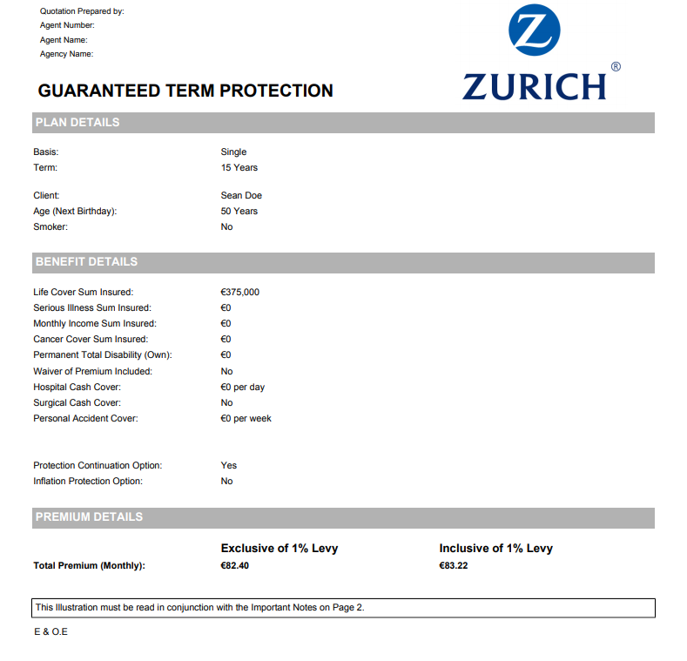
Case Study – Solicitor’s Practice
Quote Details: Basis: Single Life Term: 15 years Client: Sean Age Next: 50 years Life Cover: €375,000 Protection Continuation: Yes Total Monthly Premium: €82.40 Exclusive of Levy €83.22 Inclusive of Levy

Slide 70
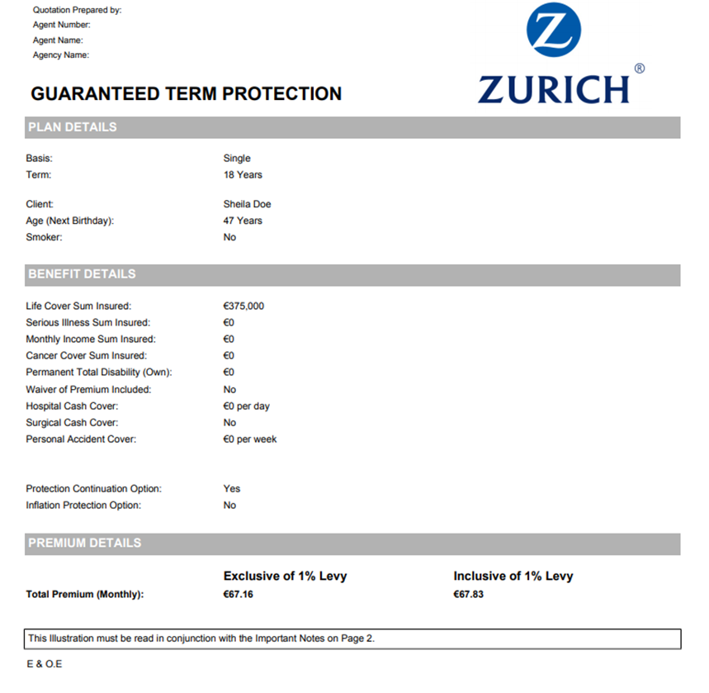
Case Study – Solicitor’s Practice
Quote Details: Basis: Single Life Term: 15 years Client: Sheila Age Next: 47 years Life Cover: €375,000 Protection Continuation: Yes Total Monthly Premium: €67.16 Exclusive of Levy €67.83 Inclusive of Levy

Slide 71

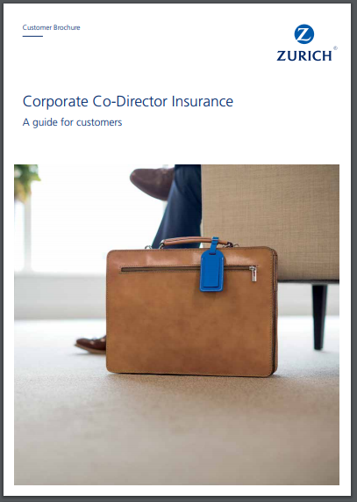


Business Insurance from Zurich Life

Slide 72

Pension Adjustment Orders
Ger Tyrrell
Technical Services
Zurich Life

Slide 73
Pensions - Recent Developments
Increased awareness of the value of the pension as an asset
Turmoil in Financial World and purging of savings/liquid assets means that pension assets now account for a larger percentage of net worth
Future pension coverage in Ireland to increase with Auto enrolment of private sector due by 2022 (self employed also able to opt in)
Conclusion: Now more important than ever for Family Law Solicitors to take all assets of the marriage into account when separation or divorce occurs

Slide 74
What is a Pension Adjustment Order (PAO)?
Court order advising trustee’s of a scheme to designate or not designate a portion of a members benefits to another part
PAO necessary to note the Court’s instruction regarding the pension asset’s and split asset’s where required
Separation Agreements/Terms of Settlement alone are not sufficient

Slide 75
Relevant Legislation/Guidelines
- Family Law Act 1995 (Section 12)
Family Law (Divorce) Act 1996 (Section 17)
Civil Partnership & Certain Rights & Obligations of Cohabitants Act 2010 (Sections 121 & 187)
Pensions Authority Guidance Notes (www.pensionsauthority.ie)

Slide 76
Pension Adjustment Orders
Key information to be included in order –
Pension scheme to which it relates,
Trustee’s on which it is served,
Benefits to which it relates,
Scheme Member,
Beneficiary under the Order & correspondence address,
Instruction as to how to designate benefit,
Must specify 2 items in order to calculate benefit:
  - Relevant Period (Retirement Benefit Only)
  - Relevant Percentage (0.01% - 100%)
76

Slide 77
Pension scheme to which it relates
Pensions in scope of legislation
Occupational Pension Scheme (DB or DC)
Public Sector Scheme
PRSA
Personal Pension
Pension Annuity
Personal Retirement Bond (Buy Out Bond)
AVC’s
ARF/AMRF? – Property Adjustment Order more commonly used

Slide 78
Persons upon whom the order is served
Who are the Trustee’s?
- Occupational Pension Scheme’s are Trust based arrangements
Trustee’s can be Employer, Corporate Trustee Body, Individual Trustee’s etc
- Personal Pensions, PRSA’s, Personal Retirement Bonds, Pension Annuities, Public Sector
Not Trust Based arrangements - Trustee is the administrator for the purpose of the
legislation

Slide 79
Benefits to which it relates
- Contingent Benefit Order – death in service benefits
- Retirement Benefit Order – Funds to be used to provide pension, lump sum etc
Separate Orders required for
    - Retirement Benefits
    - Contingent Benefits Benefits
    - Each separate pension arrangement

Slide 80
Example – Order on Retirement Benefits
Divorce - Mary and Dave
Mary and Dave divorce the day before Mary retires. They were married for the 30
years prior.
Mary was in a DC Pension Scheme for the last 20 years. The value of the pension is
€500,000. It is agreed that 50% of the Funds accrued over the marriage period in the
pension will be designated to Dave
PAO made pursuant to Section 17(2) of the FLA 1996 designating 50% of the Benefits
accrued over the 20 years prior to divorce.
Dave is entitled to 50% of the Fund or €250,000. This is Dave’s designated benefit.

Slide 81
Example – Order on Contingent Benefits
Judicial Separation – Paul and Linda
Paul is a member of an occupational pension scheme which provides a
Death in Service Lump Sum Benefit of 4 X Final Salary
Agreement that Linda is to benefit from the Lump Sum in the event of
Paul’s death.
PAO made pursuant to Section 12(3) of the FLA 1995 directing the
Trustee’s to pay Lump Sum to Linda in the event of Paul’s death
Trustee discretion no longer applies

Slide 82
Example - Nominal/Nil Order
Mostly receive Nominal or Nil Orders
  - specify a nominal amount (0.01%) over a 24 hour period
  - result is that no benefit is payable to the non-member spouse
  - required in order to secure a non variation order
  - PAO cannot be varied in the future assuming clause is inserted
FLA 1996 Example
“Pursuant to Section 17(26) of the Act the Provisions of Section 22 of the Act shall not apply to
this Order”

Slide 83
Before you go to court!!
It is essential that PAO’s served on scheme trustees/administrator are operable before they are certified by the court.
If a PAO is sent to the administrators in draft format, then they can advise whether the order is operable or not and if not, outline the reasons why.
If the order is operable, they can provide a letter on headed paper confirming same which is usually required by the Court.

Slide 84
Once a PAO has been made
Letter is issued to the beneficiary
Where retirement benefits are designated, default position is retention of designated benefit within the scheme
Non-member spouse (beneficiary) may also request independent benefit to be established
- Transfer options mirror the options available to the member under the scheme
- Key Advantage – non member may control fund choice in new plan
- Access is determined by the minimum age for access under the new plan but
based on the member’s age

Slide 85
Inheritance Tax Planning
Niall Concannon B.Sc, QFA FLIA, Grad Dip

Slide 86
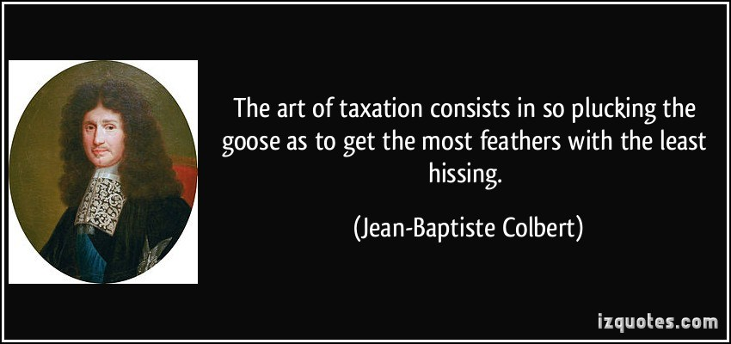

Slide 87

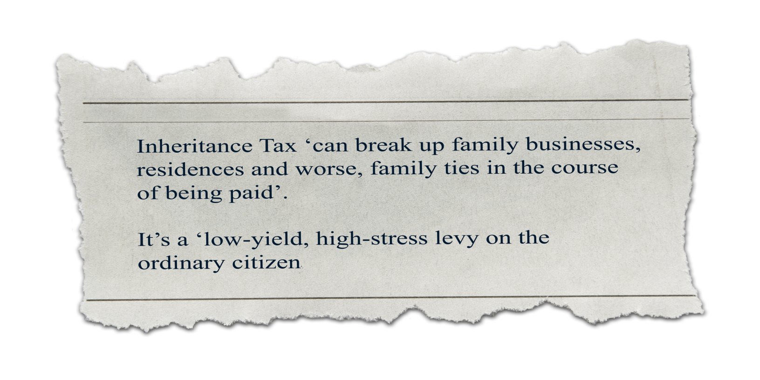
Sunday Business Post, May 2018
^{HIGHLY CONFIDENTIAL}
Notes:
87

Slide 88

Before we start…
“He who is his own attorney has a fool for a client”

Slide 89
Household wealth in Ireland
Household wealth in Ireland
2002 | €370 bn
2007 | €720 bn
2012 – Q2 | €430 bn
2017 – Q3 | €712 bn
One third of this wealth is owned by the over 65’s despite this group only accounting for just 13% of the population

Slide 90
What is taxable?
Any asset is liable to C.A.T. if
  The asset is located in Ireland;
  If the asset is located abroad and the disponer and the successor/donee is resident or ordinarily resident in Ireland
Assets can be investments, cash, land, property etc
TAX RATE: 33%
It is the person receiving the gift or inheritance (the successor/donee) who is liable for paying the tax
It is not the person providing the gift or inheritance

Slide 91
Decrease in thresholds since 2009
Group | Relationship to disponer | Group threshold 2008 | Current Group threshold
A | Son/Daughter | €521,208 | €310,000
B | Parent/Brother/Sister/Niece/Nephew/Grandchild | €54,254 | €32,500
C | Relationship other than Group A or B | €27,127 | €16,250
Tax rate has also increased from 20% to 33% which compounds the issue
Notes:
As you can see the Group Threshold for CAT has dropped significantly in the last few years and the tax rate has increased from 20% tp 33%

Slide 92
Inheritance Tax - Example
Inheritance | €1 million
Relationship - Son/Daughter Group A threshold | €310,000
Amount liable for CAT | €690,000
Tax at 33% | €227,700
Notes:
This is a very simple example of how Inheritance Tax works

Slide 93
Inheritance Tax - Example
Inheritance | €2 million
Relationship - Son/Daughter Group A threshold | €310,000
Amount liable for CAT | €1,690,000
Tax at 33% | €557,700

Slide 94
Capital Acquisitions Tax – How Much and by who?
Source:www.revenue.ie

Slide 95
Points to consider…..
When all the assets in a person’s estate are taken into account, including property, shares and investments, a child can find themselves with a large inheritance tax liability in the event of a parent dying.
Certain exemptions are available
  Spouse exemption
  Registered Civil Partners
  Dwelling House Exemption
    3 years prior and 6 years after inheritance
    Principal Private Residence of Beneficiary
    Beneficiary has no interest in any other dwelling property
  Support for Education – up to age 25
  Cost of Family Functions – i.e. Wedding
  Life Assurance Exit Tax

Slide 96

Inheritance Tax
What can you do
Do it while you are still alive!!
Get Proper advice
Split up for family and use all thresholds wisely – e.g. separates for children, in-laws and grandchildren
Use of annual €3,000 gift tax exemption
Notes:
Leaving inheritances is something you should plan for while you are still alive as there is very little that can be done afterwards. Make maximum use of thresholds where possible and also look at Annual €3000 Gift Tax Exemption

Slide 97
Annual €3,000 Gift Tax Exemption
First €3,000 of the taxable value of all taxable gifts, taken from any one individual, in the calendar year is exempt from tax
Example:
Grandfather has 10 grandchildren
Can give each child €3,000 in a calendar year (€30,000 in total)
Each grandchild’s €3,000 will be exempt from tax
Both grandparents have an exemption
Grandmother can also gift €3,000 per annum to each grandchild
So each grandchild can receive €6,000 from their grandparents
Grandparents can gift €60,000 each year free of CAT

Slide 98
Reliefs available
Agricultural Relief
  When the donee or successor is a farmer (under definition) the market value of all agricultural property (as defined) is reduced by 90%
Business Relief:
  Provides for a reduction of 90% in the taxable value of all relevant business property
Favourite nephew/niece
  Reclassifying a nephew/niece of a disponer as a child
  Hence qualifying for the maximum inheritance threshold of €225,000

Slide 99
Agricultural and Business Relief – the difference
Inheritance |  |  | €2 million
Relief @90% |  |  | €1.8 million
Balance |  |  | €200,000
Group Threshold |  |  | €310,000
Tax Due |  |  | Nil
 | Versus
Inheritance |  |  | €2million
Group Threshold |  |  | €310,000
Balance |  |  | €1,690,000
Tax due |  |  | €557,700

Slide 100

Farm Relief
Where can it go wrong?
Notes:
A friend of John Hayes – worked as a chemist and inherited a farm. Had to give up working as a chemist to avail of Farm relief as otherwise he would have been hit with a huge CAT Bill. Hates farming. Now 5 years into 6 years but is a bitter man!!

Slide 101

Paying Inheritance Tax
Problems
  Lack of cash in estate
  Unable to split un-splittable assets
  Unable to liquidate illiquid assets – i.e. property
Notes:
People can have liquidity problem in paying inheritance tax as often assets cannot be liquidated and split between beneficiaries for example

Slide 102
Who pays the Inheritance ?
The Beneficiary
Problems
  If valuation date between 1st January and 31st August;
    you must complete tax return and pay tax on or before 31st October in that year
  If valuation date is between 1st September and 31st December;
    you must complete tax return and pay tax on or before 31st October in following year
  Surcharge for late payment:
    if less than 2 months late – 5% up to a max of €12,695
    Greater than 2 months – 10% up to a max. of €63,485

Slide 103

Cohabiting Couples
Certain Rights and Obligations of Cohabitants Act 2010
Cohabitant
One of two adults (whether of the same or the opposite sex) who live together as a couple in an intimate and committed relationship and who are not related to each other.
  Not Married and Not Civil Partners
Qualified Cohabitant
An adult who is in a relationship of cohabitation of 2 years or more if dependant children are involved or for 5 years or more in other instances
  Although not automatically entitled, now legally entitled to claim from the deceased cohabitant’s estate but CAT is liable.
  Group C Threshold of €16,250 applies

Slide 104
Calculation of tax – Co-habitants
Co-habitants will have tax liability
If no other gifts/inheritances received under Group Threshold C of €16,250 on excess over €16,250
Or if full €16,250“used up”, tax on full amount!

Slide 105
Cohabiting Couples
Tax liability considerations
Treated as strangers from an Inheritance Tax point of view
Does Dwelling House Exemption Apply?
Co-habiting couples effecting policies of life insurance may find themselves with a C.A.T. liability of which they are unaware. If survivor is deemed not to have paid premiums, problems arise!
  Care is needed as to how policies are set up – who pays the premiums?
  Factor the inheritance tax bill into protection requirements
  Put Section 72 policy in place.

Slide 106
Policies of Life Insurance
Tax liability example
Tom Ryan and Ann Boyle who are cohabitants have a Joint Life Cover Policy of €300,000.
As it is a joint policy, there is only one premium identifiable which Ann has paid for
  Ann dies so the full €300,000 is paid to Tom as policy owner
  The full amount is deemed to have been inherited by Tom from Ann as Ann paid for the cover.

Slide 107
Policies of Life Insurance
Tax liability example
Assuming no more assets are inherited from Ann then Tom is liable for C.A.T. Of:
  (€300,000 – €15,075 Threshold ) x 33% CAT = €94,025.25
If Tom was in a position to prove to Revenue he’d paid for half the cover then he’d have a C.A.T. liability of:
  (€150,000 – €15,075 Threshold ) x 33% CAT = €44,525.25

Slide 108
Co-habiting Couples
Approximately 1 in 10 of all families
Succession Act
Inheritance Tax is liable
Tax Exempt Threshold is only €16,250
Recommendations
  - Make a Will
  - Get Proper Advice!

Slide 109
Inheritance Tax Planning
Section 72, CAT Consolidation Act 2003
  grants a relief in relation to the proceeds of life insurance policies (which would otherwise be liable to inheritance on the death of an insured person)
  Proceeds of the life insurance policy are used to pay the inheritance tax liability on death of a person
By setting up protection policy under S72 Trust
  Inheritance tax liability can be paid off
  Any portion of policy not used in paying CAT will be liable itself

Slide 110
Section 72
Previously Section 60 policies
The policy must be effected by the life insured on his/her own life and specify it has been effected under Section 72
To qualify for Section 72, the life insured(s) must pay the premiums
The level of protection on the policy must be at least eight times the value of the premium being paid.
An existing policy cannot be converted to a Section 72 policy.

Slide 111
Example of Tax Liability
Taxable value of the inheritance (estate value) | €1,500,000
No of beneficiaries | 2
Gross inheritance to each | €750,000
Relationship | Group Threshold 1
Threshold amount | €310,000
Taxable Inheritance (each) | €440,000
Taxable amount @ 33% | €145,200
Net inheritance (assuming no S72 policy) | €604,800
Total Inheritance Tax Due (sum insured on S72 policy) | €290,400(€145,200 x 2)

Slide 112
Illustration of S72 Policy
Assuming:
  Joint Life 2nd Death policy
  Guaranteed Whole of Life
  Male 55 next non-smoker
  Female 52 next non-smoker
Sum Insured on policy = €290,400 (tax payable)
Total premium required = €342.96 per month
Net effect is tax is paid and children get full €750,000 into their hands

Slide 113
Communicating with the family
Only 45% of wives kept their assets with the same financial advisor after death of husband
Only 2% of children kept their inheritance with the parents financial adviser

Slide 114
Section 73 Policies (formerly Section 119)
Savings Plans – proceeds in the event of a full or partial surrender exempt from Gift Tax when used to pay Gift Tax in connection with a lifetime gift made by the owner of the plan, within one year of the encashment of the plan
  Must be expressly effected under the provisions of S.73 (usually endorsed)
  Person who takes out plan must pay the premium
  Joint Life can only be taken out by a married couple or registered civil partner
  If you stop paying premiums even after 8 year period you cannot restart
  Premium cannot increase or reduce by more than 50% in any continuous 8 year period
  Once regular premiums have been paid for at least 8 years, any encashment will be exempt from Gift Tax when used to pay Gift Tax within one year of the encashment

Slide 115
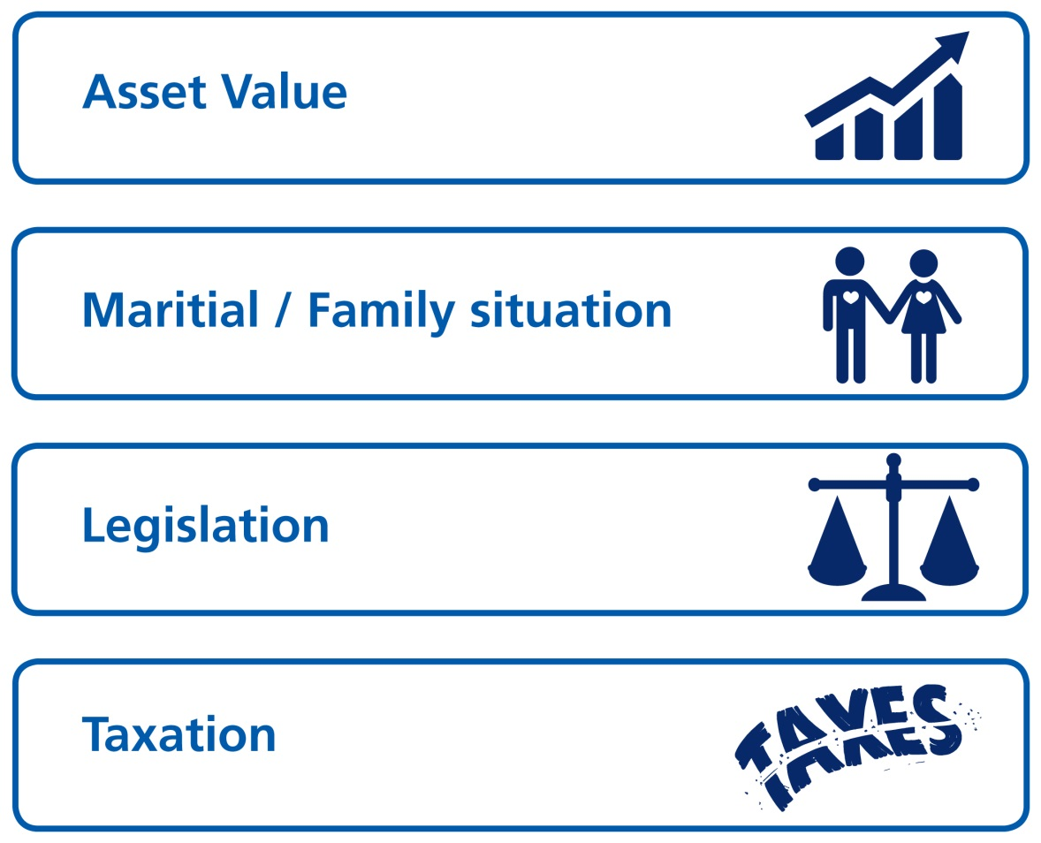
Regular Reviews
Notes:
Finally there is a need for regular reviews as circumstance change.

Slide 116
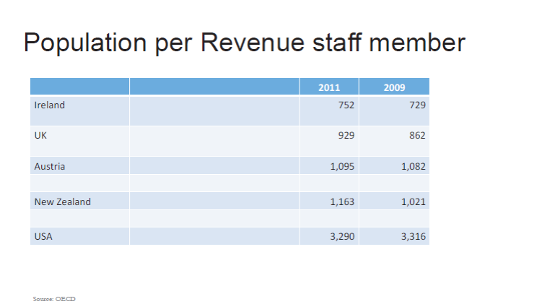

Slide 117
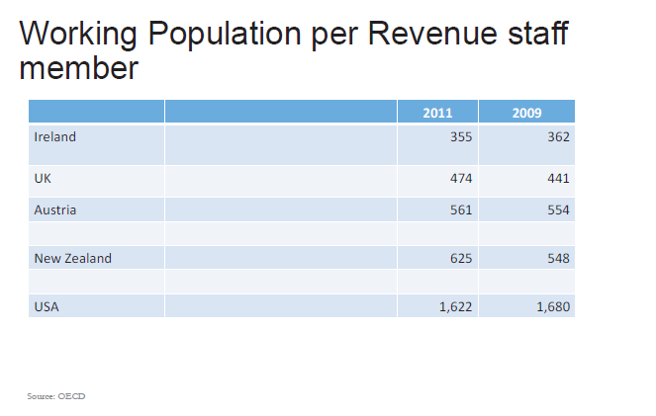

Slide 118
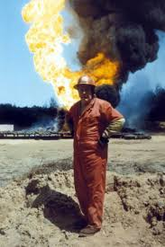
On ‘Professionalism’
If you think it’s expensive to hire a professional to do the job, wait until you hire an amateur”.
Red Adair

Slide 119
…Further Information
Revenue Website - http://www.revenue.ie/en/tax/cat/index.html
CMCC Financial Services – Tel. 093 34033 or www.cmcc.ie

Slide 120

Thank you
Zurich Life Assurance plc is regulated by the Central Bank of Ireland.

