Slide 1
Galway Solicitors Bar Association Employment Law Update
Jason Murray BL
11-May-2018

Slide 2
Right to Cross Examine/Legal Representation
Harassment/Sexual Harassment
Age Discrimination: Challenging Retirement Ages.

Slide 3
Right to cross examine/legal representation
Lyons v Longford Westmeath Education and Training Board [2017] IECH 272
E.G. v Society of Actuaries in Ireland [2017] IEHC 392
N.M. v Limerick and Clare Education and Training Board [2017] IEHC 588

Slide 4
Facts of Lyons
Mr Lyons was accused of bullying by another employee
Employer hired a HR company to carry out investigation
At no stage was Mr Lyons permitted to cross-examine his accuser or have legal representation.
Appealed against investigation findings – Chief Executive held that the investigation report “stands” together with the “findings”

Slide 5
Key Quotes from Lyons
““Where investigative processes can lead to dismissal, cross examination is a vital safe guard to ensure fair procedures”.
“it is the actual investigation that requires the right to cross examination and representation, that takes place prior to initiation of the disciplinary procedure under Circular 71/2014”.
concluded that the investigation carried out by Graphite Recruitment “failed to adopt fair procedures, in contradiction of the dicta of Supreme Court . . .”.

Slide 6
Points of Note
Lyons makes clear that there is a right to representation and cross-examination in a pre-disciplinary investigation – where there is a finding as a result of the investigation
The disciplinary stage here was to determine the disciplinary action
Rights seem to be confined to stages where there is going to be a finding (N.M. suggests representation may be needed at interviews)

Slide 7
E.G. v Society of Actuaries in Ireland [2017] IEHC 392
Mr E.G. accused of professional misconduct
Investigation committee had a defined role: (a) whether there was prima facie evidence of misconduct, and (b) whether to refer the matter to a disciplinary tribunal
Investigation stage did not make final or binding findings of fact
Final decision on the finding of fact was left to a separate decision maker

Slide 8
Mr Justice McDermott Held:
In the courts view it was not necessary for the first named respondent to afford to the applicant the full panoply of natural justice rights in the course of any investigation into his conduct . . . They were of course, obliged to treat him fairly but they were entitled to adopt less formal and more abridged procedures . . .
. . . the full panoply of natural justice rights does not inexorably apply at every phase of an investigative process. An appropriate standard of fair procedures must be applied at all stages of a tiered process. There may be situations in which a stronger degree of procedural protection may be required having regard to the decision to be taken at an investigative stage or its potential consequences.
A full oral hearing will be required before the Disciplinary Tribunal following the referral in the course of which the full panoply of rights will be available as set out in the Scheme as already described.

Slide 9
Points of Note from E.G.
Curtails the broad scope of Lyons
Clarifies the position in preliminary steps which do not make determined findings of fact
Allows for employers to adopt a more informal position in the early stages of investigations
The full range of rights in terms of cross examination do come into force at a final decision making stage

Slide 10
N.M. v Limerick and Clare Education and Training Board
Principal in a disciplinary process – accused of sexually harassing a teacher
Similar to E.G. had been refused the full array of rights at the investigation stage
Following the investigators report, Mr N.M. was provided with an opportunity to attend a disciplinary hearing with the Chief Executive where he could challenge all of the evidence against him

Slide 11
Mr Justice McDermott Held:
The decision to be taken by the investigators in this case could not be regarded as a final or binding finding of fact against the applicant. The procedure under the Circular requires an extensive hearing before determination . . .
The Applicant “has a right to challenge any evidence that is being relied upon”
In terms of the seriousness of the allegations, it was noted: that would necessarily require that [the applicant] be afforded the opportunity to cross examine any person making an allegation against him or whose testimony he seeks to challenge

Slide 12
Points to Note
Reaffirms the position in relation to pre-disciplinary steps which do not make binding findings of fact.
The applicant had secured the right to legal representation at any interview held by the investigators.
No right to cross examine witnesses at the early stages where there is no binding findings of fact.
Full array of rights to be afforded to the employee at the stage where there is to be a binding finding of fact

Slide 13
Other Relevant High Court Decisions
Shortt v Royal Liver Assurance:
  Right to cross-examine PA was not upheld;
  Held that the adjudicator was entitled to consider the likelihood of a detrimental effect on the PA by being confronted by the Plaintiff
A Worker v A Hospital:
  Hospital worker accused of sexual abuse was seeking to cross-examine the patient
  Court balanced the risk of the mentally frail patient giving evidence v the risk of injustice as against the employee
  Questioning through a trained person, not at the hearing, permitted

Slide 14
WRC Decisions
ADJ-00006103
  AO seemed willing to set aside a finding of misconduct based on a process that limited cross examination
  Shows a willingness to critically evaluate investigative and disciplinary procedures
ADJ-00006788
  AO found no requirement for cross examination, evidence was looked at (CCTV) at all stages and even if the Employee was represented, little difference would have arisen
  AO influenced by the fact the employee had already engaged legal representation for a PI claim against his employer

Slide 15
Recap of Cross Examination and Representation
As per Lyons: if facing allegations which can lead to dismissal – right to cross examine and representation
If merely a fact gathering exercise – employee does not enjoy the full array of rights
If findings made at the investigation stage are final – employee enjoys full range of rights
If sanction is less than dismissal – internal process and the employee does not enjoy the full range of rights

Slide 16
Harassment
Section 14A(7)(a)(i):
  Unwanted conduct related to any of the discriminatory grounds

Slide 17
Sexual Harassment
Section 14A(7)(a)(ii):
  Form of unwarranted verbal, non-verbal or physical conduct of a sexual nature
Section 14A(7)(b):
  Purpose or effect of violating a person’s dignity and creating an intimidating, hostile, degrading, humiliating or offensive environment for the person
NB: This imports a subjective test on the personal response of the individual who is the subject of the unwarranted conduct.

Slide 18
Defence Open for Employers
Sections 14A(2) & 15(3): employers have a defence if they can show that they took such steps as were reasonably practicable to prevent the employee from doing the act which is found to have constituted harassment or from doing in the course of his employment acts of that description
Reasonably practicable has not been defined within the Acts: there is some guidance from the Employment Equality Act 1998 (Code of Practice) (Harassment) Order 2012.

Slide 19
An Employer v A Worker EDA 0916
The employer tried to use the defence as prescribed. However the reasonably practicable steps were taken after the harassment:
  It may be commendable in itself, it is insufficient to make out the defence contemplated by section 14A(2) of the Act. In order to avoid liability it is essential for the Respondent to establish that it had in place, at the time at which the harassment occurred, arrangements intended to prevent and deal with the occurrence of such conduct

Slide 20
McCanley v Dublin Bus [2016] 27 ELR 81
Facebook messages
Highlights the broad scope of the protections of the acts
Employers need to be aware of the changing landscape and update policies where necessary
The Labour Court noted that it was not whether the wrongdoer was acting in the course employment, but if the employee suffered the harassment in the course of his employment.

Slide 21
A Receptionist v A Car Parts Company
Award of €46k (just under two years wages) awarded to employee
Employer was found to have made vile sexual comments in relation to the employee – she complained to the MD who did not act on the complaint or give her a copy of the sexual harassment policy

Slide 22
Age Discrimination: Retirement Ages
Mandatory Retirement can be challenged by way of:
  a claim for Unfair Dismissal;
  a claim for Age Discrimination; or
  potentially a claim for Breach of Contract.

Slide 23
Defences to Claims
Section 2(1)(b), Unfair Dismissals Act 1977, as amended:
  an employee who is dismissed and who, on or before the date of his dismissal, had reached the normal retiring age for employees of the same employer in similar employment or who on that date was a person to whom by reason of his age the Redundancy Payments Acts, 1967 to 1973, did not apply.
Section 34(4) of the Employment Equality Acts permits compulsory retirement age as non discriminatory but only where it is objectively justified:
  (4) Without prejudice to subsection (3), it shall not constitute discrimination on the age ground to fix different ages for the retirement (whether voluntarily or compulsorily) of employees or any class or description of employees if—
  (i) it is objectively and reasonably justified by a legitimate aim, and
  (ii) the means of achieving that aim are appropriate and necessary

Slide 24
Code of Practice on Longer Working (SI 600/2017)
Sets out the following as objective justification:
  Intergenerational fairness (allowing younger workers to progress);
  Motivation and dynamism through the increased prospect of promotion;
  Health and Safety (generally in more safety critical occupations);
  Creation of a balanced age structure in the workforce;
  Personal and professional dignity (avoiding capability issues with older employees); or
  Succession planning.

Slide 25
Transdev v Michael Chrzanowski
Luas Driver who was forced to retire at 65.
The Labour Court pointed to a number of factors when deciding the case:
  the Group Pension Scheme had been collectively negotiated by the Union and the Complainant had signed the agreement;
  the Complainant had become a member of the Pension Scheme, which made explicit reference to retirement at 65 years, a number of years before;
  all workers (with some exceptions) who retired from their employment did so at 65 years; and
  the Complainant had, some months before, sought to extend his employment beyond his 65th birthday

Slide 26
Transdev v Michael Chrzanowski Ctd.
The Labour Court concluded in determining the Objective Justification:
  the instant case, the Court notes that the medical opinion furnished, which was not disputed by the Union, associates age related changes and visual perception with conditions that increase the risk of driving for older workers. In such circumstances, the Court accepts that to impose an upper age limit on the retention of tram drivers in order to protect the health and safety of drivers, passengers and the general public is reasonable in the circumstances and can constitute genuine and determining occupational treatment and is legitimate and proportionate. The Court finds that the Respondent has set out reasonable grounds that objectively justify a retirement age of 65. . .

Slide 27
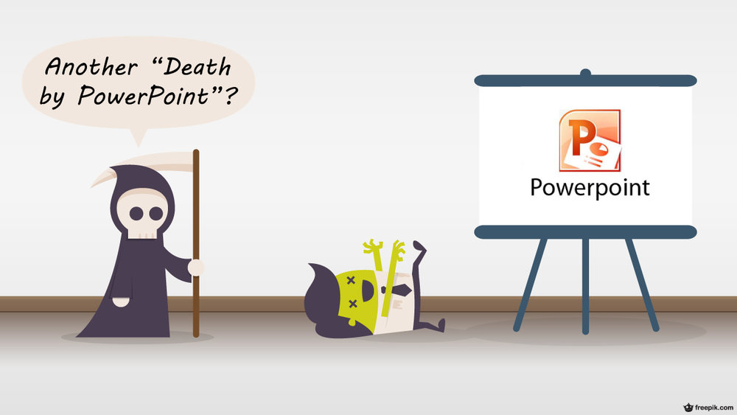
Thanks for listening, hope it wasn’t:

